Slide 1
Momentum

Slide 2
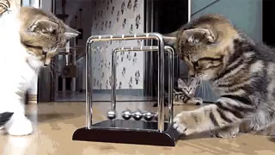
In this Smart Lesson you will learn to:
Define the term momentum.
Solve simple momentum calculations.

Slide 3

You may have come across the term momentum in everyday usage.
For example, a sport team may be described as "having momentum". This refers to them being unstoppable, such as when they win game after game.
It is also used in politics to describe candidates who seem to be unstoppable on their rise to power.
So what does the term momentum mean in physics?

Slide 4
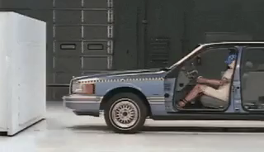
In physics, momentum refers to a property of moving bodies.
It is the tendency for a moving object to keep moving in the same direction. An object with lots of momentum is hard to stop!
Think about when you are travelling in a bus or car and the vehicle suddenly stops. What happens to you?
You get thrown forward - your momentum tries to keep you moving in the original direction. This is why seatbelts are so important!

Slide 5

Momentum is a vector quantity.
This means it has direction as well as magnitude.
So how do we calculate momentum?
Which is easier to stop, a bike travelling slowly or a bike travelling very fast? Pretty obviously it is easier to stop the bike travelling slowly, so momentum is affected by the velocity of the object.

Slide 6

What else affects momentum?
Which is easier to stop: a runaway empty shopping trolley or a full shopping trolley? In this case, it is obviously easier to stop the empty trolley, so momentum is affected by mass.

Slide 7

Momentum (p) is the mass (m) of an object multiplied by its velocity (v), as shown by the formula:
p = mv.
Objects that are very massive or moving very fast have a large momentum.
This is an important concept because it turns out that momentum principles can be used to solve problems like collisions, where two or more objects hit each other.

Slide 8
